Slide 1
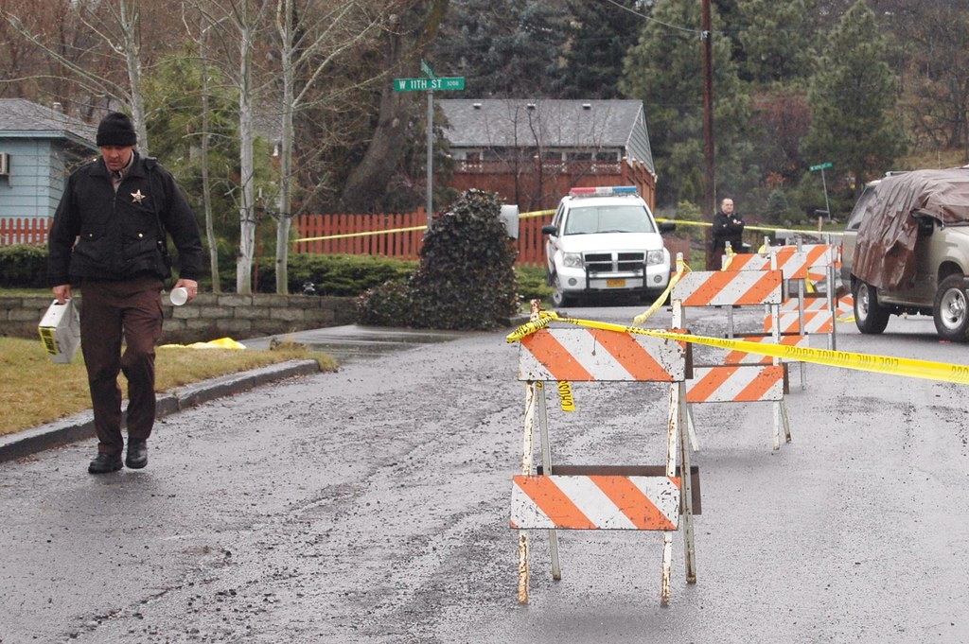
Homicide Victim Analysis

Slide 2
Data Source
Data source:
https://data.london.gov.uk/
https://data.gov.uk/
Homicide Victim Analysis

Slide 3
Victim Table
Homicide Victim Analysis

Slide 4
Victim number
Homicide Victim Analysis

Slide 5
Victim Gender
Homicide Victim Analysis

Slide 6
Victim Age
Homicide Victim Analysis

Slide 7
Domestic Abuse
Homicide Victim Analysis

Slide 8
Victim Ethnicity
Note - London population by ethnicity in percentage:
White: 59.8
Asian: 18.5
Black: 13.3
Other: 8.4
Source: https://www.ethnicity-facts-figures.service.gov.uk/uk-population-by-ethnicity/national-and-regional-populations/regional-ethnic-diversity/latest
Homicide Victim Analysis

Slide 9
Victim Ethnicity by year
Homicide Victim Analysis

Slide 10
Victim Killing Method
Homicide Victim Analysis

Slide 11
Victim Killing Method by year
Homicide Victim Analysis

Slide 12
Victim Borough
Homicide Victim Analysis

Slide 13
Victim Borough by year
Homicide Victim Analysis

Slide 14
Borough population table
Homicide Victim Analysis

Slide 15
Borough population in 2010
Homicide Victim Analysis

Slide 16
Join Borough population and victim (preparation)
Homicide Victim Analysis

Slide 17
Join Borough population and victim
Homicide Victim Analysis

Slide 18
Borough victim against population by year
Homicide Victim Analysis

Slide 19
Create table to calculate average rank of 10 years
Homicide Victim Analysis

Slide 20
Borough Rank (least homicide in 2012 – 21)
Homicide Victim Analysis

Slide 21

Summary
Finding
There is increasing trend of Black being victim of homicide.
There is increasing trend of knife or sharp implement as killing method.
Some boroughs had less cases of homicide, comparing against its population
Recommendation
More police force might be required for borough with more cases (say Ealing)
Further study might be worth to find out why some boroughs (say Ealing) has more case, and why some boroughs (say Bromley) has less case, and whether any finding could be applied.
Homicide Victim Analysis

